Slide 1
HOW TO IMPROVE MY FICO SCORE?
by:
Dr. Scott Kehiaian

Slide 2
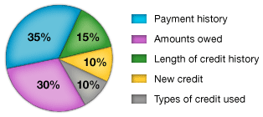
HOW TO IMPROVE MY FICO SCORE?
FICO SCORE BREAK DOWN

Slide 3
HOW TO IMPROVE MY FICO SCORE?
Payment history (35%)
The first thing any lender wants to know is whether you've paid past credit accounts on time. This is one of the most important factors in a FICO® Score.
http://www.myfico.com/CreditEducation/Credit-Payment-History.aspx

Slide 4
HOW TO IMPROVE MY FICO SCORE?
Amounts owed (30%)
Having credit accounts and owing money on them does not necessarily mean you are a high-risk borrower with a low FICO® Score.
http://www.myfico.com/CreditEducation/Amounts-Owed.aspx

Slide 5
HOW TO IMPROVE MY FICO SCORE?
Length of credit history (15%)
In general, a longer credit history will increase your FICO® Score.
Your FICO Score takes into account:
how long your credit accounts have been established including the age of your oldest account, the age of your newest account and an average age of all your accounts
how long it has been since you used certain accounts

Slide 6
HOW TO IMPROVE MY FICO SCORE?
Types of credit in use (10%)
The score will consider your mix of credit cards, retail accounts, installment loans, finance company accounts and mortgage loans.

Slide 7
HOW TO IMPROVE MY FICO SCORE?
New credit (10%)
Research shows that opening several credit accounts in a short period of time represents a greater risk - especially for people who don't have a long credit history.

Slide 8
HOW TO IMPROVE MY FICO SCORE?
OTHER HINTS:
Those with scores above 760 can not easily improve their scores. Those with scores below 700 can have more immediate impact.
If you don’t have a credit card, consider applying for one. If you can’t get an unsecured card, try getting a secured card.
Add an installment loan to the mix.

Slide 9
HOW TO IMPROVE MY FICO SCORE?
OTHER HINTS:
Pay down your credit cards.
Pay down the cards that are approaching their maximum limits first.
Use your credit cards lightly. If you put large amounts on credit cards every month, your last statement amount will be reported and may hurt your scores.

Slide 10
HOW TO IMPROVE MY FICO SCORE?
OTHER HINTS:
Check your limits that are reported to the credit bureaus for accuracy.
Use all of your cards periodically so they can’t be closed or not reported to the bureaus.
If you have a late payment on your record, after you are on-time paying your accounts for 12 months, see if the lender will take off that one late payment.

Slide 11
HOW TO IMPROVE MY FICO SCORE?
OTHER HINTS:
Dispute old negatives on your reports.
Dispute all significant errors including:
Late payments, charge offs
Credit limits reported incorrectly
Accounts that are listed as unpaid after bankruptcy
Negative items older than 7 years

Slide 12
HOW TO IMPROVE MY FICO SCORE?
Common Mistakes
Asking a creditor to lowering your credit limits.
Closing old accounts.
Making late payments.
Consolidating accounts instead of paying them down.
Applying for new credit unnecessarily.

Slide 13
HOW TO IMPROVE MY FICO SCORE?
WATCH VIDEO:
https://www.youtube.com/watch?feature=player_embedded&v=ssxpL_KLSVQ

Slide 14
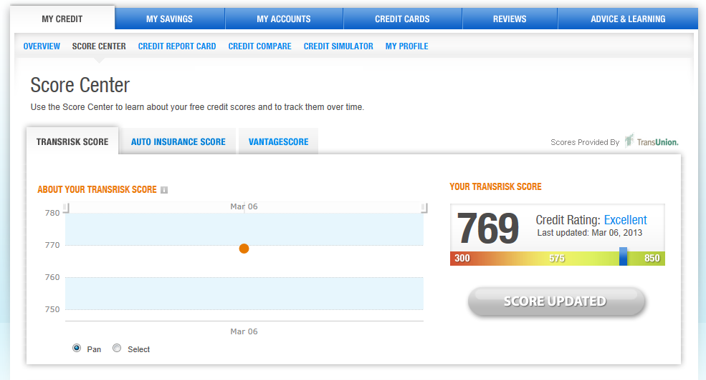
HOW TO IMPROVE MY FICO SCORE?
CREDIT KARMA

Slide 15
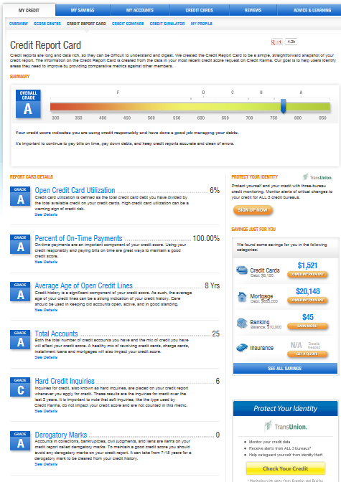

Slide 16
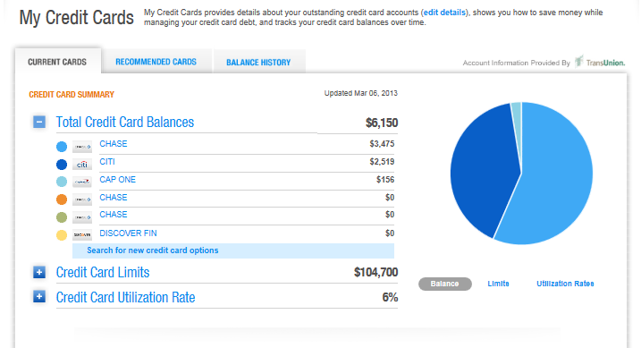

Slide 17
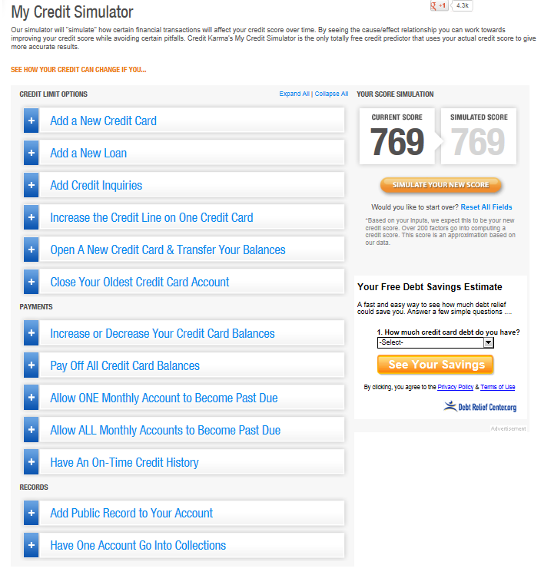

Slide 18
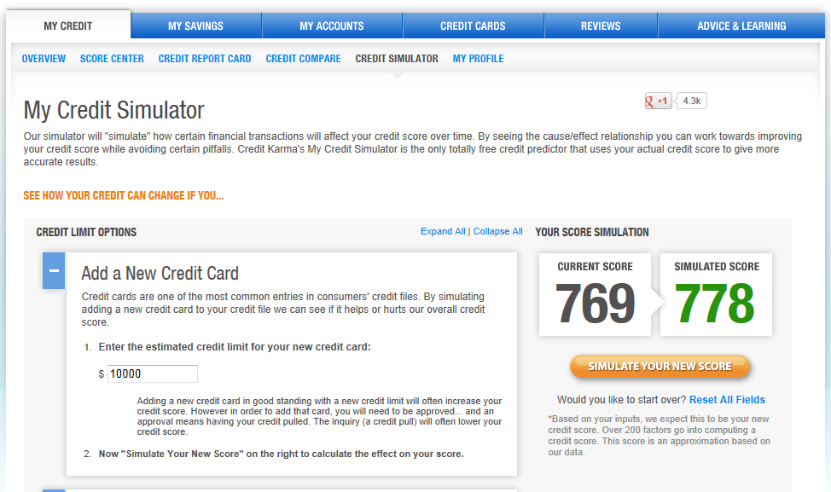

Slide 19
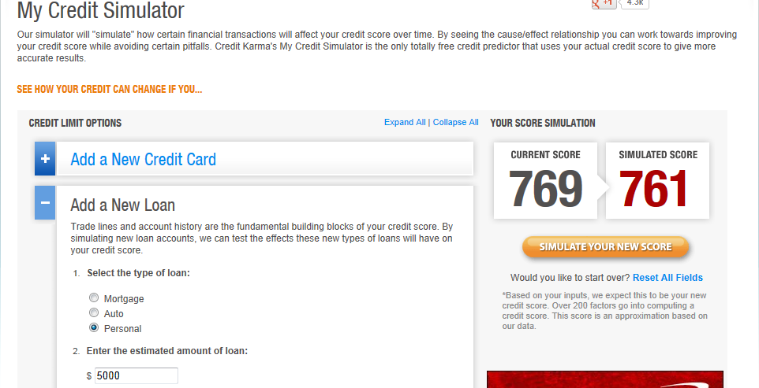

Slide 20
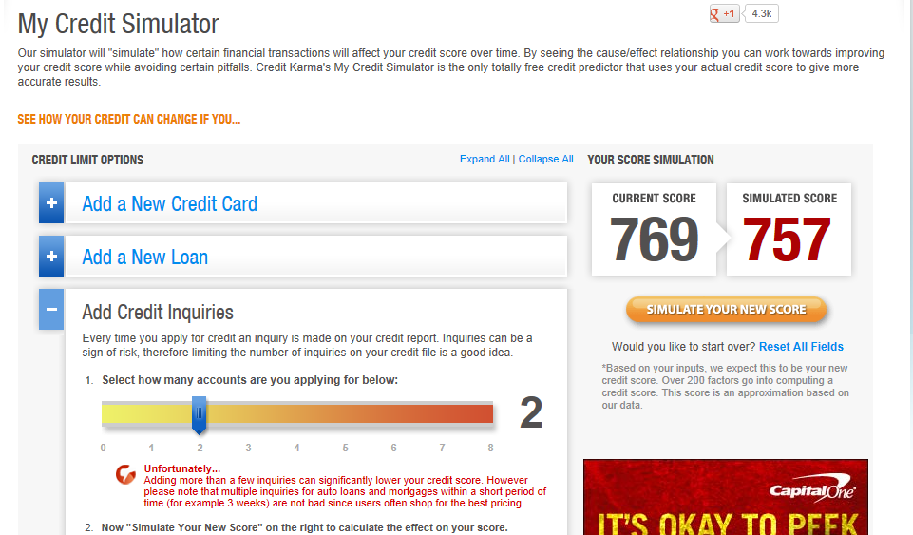

Slide 21
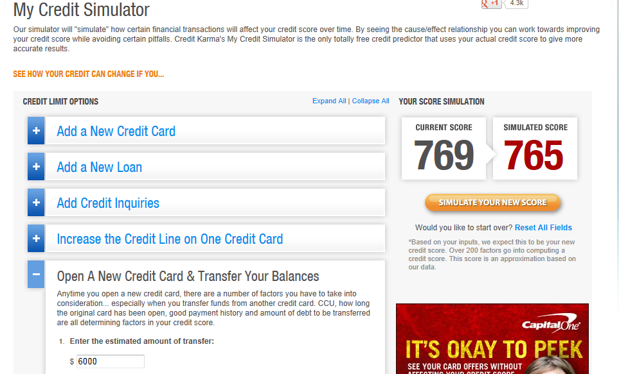

Slide 22
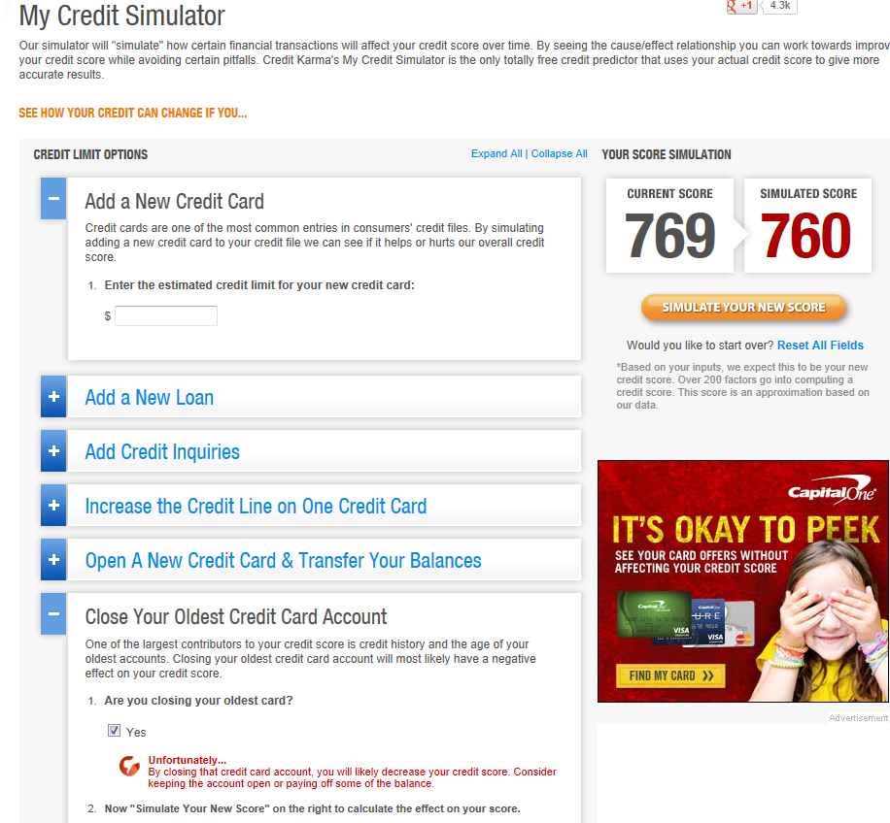

Slide 23
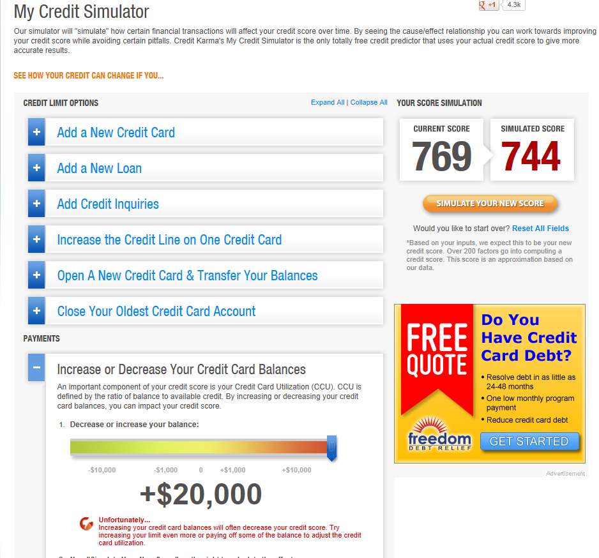

Slide 24
