Slide 1
THE WHAT? WHERE? WHY? OF CREDIT REPORTS
Office of Frank M. Pees, Chapter 13 Trustee
Worthington, OH 43085

Slide 2
What is a credit report?
A report issued by credit bureaus or consumer reporting agencies (CRAs) to credit grantors, potential employers, insurance companies, and consumers.
The report contains personal information; details about a person’s credit history; public record information; and inquiries.
The information is compiled from companies or credit lenders called providers or furnishers.
The information on the report is used to calculate a credit score based on the end user’s credit score model.
FICO is the most common scoring system used to make credit, employment, and insurance premium decisions.

Slide 3
FTC & Fair Credit Reporting Act (FCRA)
Federal Trade Commission and bank regulators supervise those companies that comprise & utilize the credit system.
FCRA, 15 U.S.C. 1681 is the primary law regulating the credit scoring system.
Fair and Accurate Credit Transactions Act (FACT Act) of 2003 amended FCRA to provide free access to credit reports to consumers.

Slide 4
Fair & Accurate Credit Transaction Act (FACT Act)
Allows consumers to obtain a free credit report once every twelve months from each of the three national credit companies:
Equifax
Experian
TransUnion
Contains provisions to help prevent identity theft.
Fraud alerts
Active Duty alerts
Prohibits disclosing more than 5 digits of account number on receipts.

Slide 5
What Information is on Credit Report?
All reports have sections for:
Personal Information
Account Information
Inquiries
Public Records
Some reports have optional separate sections for:
Credit Summaries
Open Accounts
Closed Accounts
Derogatory Accounts
Satisfactory Accounts

Slide 6
Other Required Information
FCRA requires all credit reports to have contact information including name, address, and phone number for any bureau which provided your report.
FACT Act requires credit reports to have information about your rights as a consumer, answers to common questions, and your right to correct errors.

Slide 7
Personal Information
Name, address, social security number, birthdate, and employer.
Can include both current & former addresses & employers.
Personal information is submitted every time the provider/furnisher updates the account information.
May be wrong if the information is entered or reported incorrectly by providers.
This information does not affect your credit score.
May be indicative that some other person’s information is included on your report.

Slide 8
Account Information
This section factors very heavily in your credit score.
Discloses all open, closed, satisfied, settled, derogatory accounts, and collection accounts for at least the last seven years.
Each account is called a trade line.

Slide 9
Account Information – Con’t.
Each trade line includes Name of Lender & account no.:
Some digits may be masked or may be random by design.
Can include address and phone number of lender and type of lender.
The type of lender is a factor considered in calculating the credit score.
Types include banks, credit unions, mortgage lenders, auto lenders, merchant lenders, and finance companies.
The FICO scoring system favors banks and national credit card companies and penalizes finance company accounts.

Slide 10
Account Information – Con’t.
Each trade line includes three Dates:
Open date, last reporting date, & last active date.
Open date is the month/year account was opened. Very important factor in credit score. Length of time accounts are open, number of accounts opened in last 12 months, & length of time since new account was opened are all important factors.
Last reporting date is most recent month/year the provider/furnisher reported the information.
Last active date is the last month/year a payment was made. Recent payment activity is more helpful than closed accounts paid on time.

Slide 11
Account Information – Con’t.
Each trade line includes Account Information:
Type of account (Revolving, Installment, Mortgage, Other.) FICO score reflects types of accounts and how frequently used.
Balance due is the last reported balance by the provider/furnisher, not necessarily the current balance or the balance after your last payment.
Amount past due will drop score significantly.
Initial loan amount or highest credit limit. If limit exceeds the credit line, it can cause a drop in credit score.

Slide 12
Account Information – Con’t.
Each trade line includes Payment history information:
Pays as agreed, late payments, derogatory accounts.
Each bureau has own method of reporting monthly payment information and late payments.
Some lenders report a 30-day late payment at 31 days while other lenders may wait much longer.
Derogatory accounts include charged-off, collection accounts, consumer credit counseling, settled accounts, foreclosures, repossessions, bankruptcy.

Slide 13
Account Information – Con’t.
Charged-off accounts are considered bad debts that are at least 180 days past due.
Lenders can pursue the bad debt through their internal collections department, sell or assign the debt to a collection agency, or pursue legal action.
Lenders make a cost-benefit analysis in determining their plan of action.
Higher debt amount or a higher credit score makes it more likely lender will actively pursue collection.
Secured debts are more likely to be pursued through legal action.

Slide 14
Where to get the free reports?
CreditReport.com ???????
FreeCreditReport.com ???????
FreeCreditScore.com ???????
FreeAnnualCreditReport.com ???????
GetFreeCreditReportInformation.webs.com ???????

Slide 15
JUST SAY NO
A BIG NO TO ALL THOSE WEBSITES & MANY MORE

Slide 16
This one is Safe, Approved, Regulated, and FREE:
AnnualCreditReport.com
The only official website to get your free reports with no strings attached.
There are many imposter sites which may provide a report but, in turn, you are signing up for some sort of monthly subscription service. You are billed monthly from $9.99 per month to $29.99 per month until you cancel the service.

Slide 17
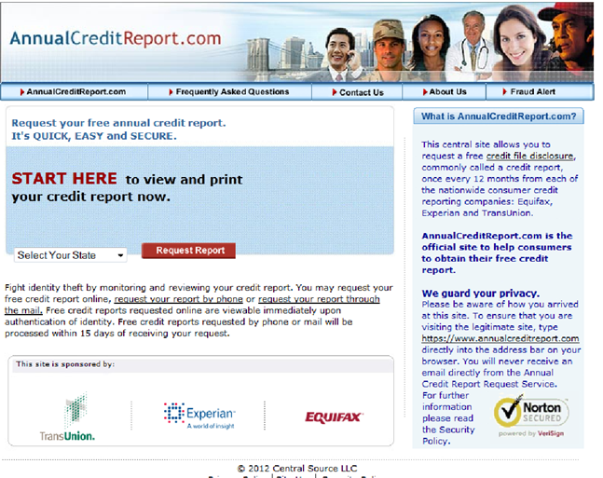

Slide 18
Three ways to obtain reports
Online immediately with correct answers to security questions.
Mailed to you within 15 days:
by calling1-877-322-8228 or,
by mailing a completed request form.
Free reports do not include credit scores.

Slide 19
Which report should you review?
Important to check all three reports. Not all lenders report to all three bureaus.
To check continually throughout the year, request a report every four months, alternating bureaus.
Review each one carefully and highlight any incorrect or outdated information.
Check all information including personal information.
Check for duplicate accounts.
Check inquiries listed at end of report.

Slide 20
Why Have Credit Reports?
The end result of credit reports is to generate a credit score.
Several different scoring models exist but over 90% of credit lenders and insurance companies use the FICO scoring system.
FICO scores can be obtained at www.myfico.com.
Your score depends on information on report on the day the score is requested.
Credit score at bankruptcy discharge depends on what credit score was at time bankruptcy was filed.

Slide 21
FICO Scoring Systems
Classic FICO – first scoring model still used by major mortgage investors.
FICO Next Generation – began in 2001 and is used by many auto lenders and credit card companies. Lessens negative impact from finance company accounts.
FICO 8 – newest scoring model not widely used. Lessens impact from late payments after 5 years rather than 7.
Experian, Equifiax, TransUnion make individual adjustments to the FICO score.
Not all lenders report to all credit bureaus. Major lenders are more likely to report to all three than local or small lenders.

Slide 22
Disputing incorrect information
File disputes in writing, online or by form or letter.
Clearly identify the trade line and account number.
Be specific about what action you expect and why.
Send supporting documentation, if needed.
Keep copies of what you send or who you speak with.
Follow up with telephone call to number listed on report, if necessary.
Credit bureaus must investigate your disputed information within 30 days.
If creditor can’t verify their information is correct, it must be removed and a new report will be sent to you.

Slide 23
After Bankruptcy Discharge
Bankruptcy should be noted DISCHARGED in the Public Record Section.
Balance of each discharged debt should be reported as zero balance, including debts paid less than 100% and debts listed as NOT FILED on Final Report.
Past due balance of each discharged debt should be 0.

Slide 24
Consumer statement
When disputes are unresolved or accurate negative information remains, consumers may write a statement to be included in the reports.
Statement of explanation should be 100 words or less.
Use the statement for damage control, not to whine: state the facts to explain the dispute or to clarify the situation.
Statement will be provided to anyone requesting a report and will remain up to three years.
Statement will not affect credit score, but may make a difference if a loan officer is doing manual underwriting.
A notice of your dispute must be included any time the provider/furnisher reports the item to the credit bureaus.

Slide 25
Credit Repair Companies
Understand that credit repair takes time and persistence.
Credit repair companies cannot do anything that you cannot do yourself for free.
Be cautious. Many companies promise far more than they can produce.
They must give consumers a copy of the “Consumer Credit File Rights Under State and Federal Law” before a contract is signed.
Must provide a written contract that lists consumers’ rights and obligations.
You have a three day right to cancel. (Ohio law)

Slide 26
If Credit is Denied
Use the opportunity to find out why.
Ask what actions would be necessary to be approved.
Ask to be re-evaluated in 6 months if you are able to meet their conditions.
ACTUALLY, if you have reason to believe you may not be approved, it is better to find out lending guidelines of a company, bank, or business before you apply.
If your situation or credit score does not fall within their established guidelines, do not apply as they will not make an exception for you and your score will be reduced by at least two points.

Slide 27
ChexSystems: A special report
Each notation submitted to ChexSystems stays on file for 5 years, unless removed by the reporting financial institution.
Reports can be obtained at www.ckfraud.org/chexsystems.html
If debt is discharged in bankruptcy, report must show zero balance.
Chase offers Access Checking.
US Bank offers Second Chance Checking.
These are checking accounts with limited services.

Slide 28
Disputing Credit Errors
http://bcove.me/4zbk2zv1
Experian video on disputing credit errors

Slide 29
Information Compiled from:
The Road to 850 by Al Bingham
www.experian.com
www.myfico.com
www.ftc.gov

