Slide 1

Building A Spending Plan
Frank M. Pees Chapter 13 Trustee
Southern District of Ohio Eastern Division

Slide 2

Spending Plan or
Budgeting helps you remember:
Financial success doesn’t just happen.
Financial success as a journey.
Your financial plan is a road map to your financial success.

Slide 3
Building a spending plan may seem like a huge task at first.

Slide 4

We will give you some guidelines here to create a path to sound budgeting.
But, there are also many good books on the budgeting as
well as useful books on how
to trim expenses.

Slide 5
Benefits of Budgeting
Budgets allow you to see what you have and what you spend.
– It is your cash flow in action.
Budgeting makes you proactive instead of reactive.
Budgeting can create a non-confrontational way to talk about money.
All successful businesses work from a budget.
Budgeting is the first step in personal financial planning.

Slide 6


Before developing a plan, explore some areas in your life that can either speed up your journey or slow it down.

Slide 7
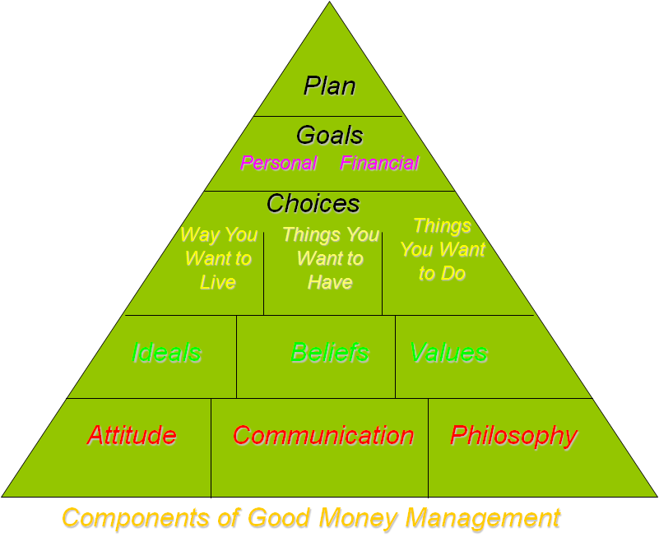
This is just a helpful way to think about your planning.
You may find you need to adjust some of the things in the boxes to achieve your goals. That’s part of the process.

Slide 8

The First Step is Attitude
We will take a quick Look at the three
foundational blocks and you can build your own Pyramid from there.

Slide 9
Just for fun, take the money attitude Quiz.
The results are NOT scientifically accurate,
they only meant to give you
Something to think about and talk about.

Slide 10
Do you agree with
the results?
If you are here
with your spouse,
Take a minute and compare.

Slide 11

Communication
This Brings us to
another foundation block.

Slide 12
Here and now is not the best time
to have an involved conversation about money.
However, here are some communication
techniques you may find useful at home.

Slide 13
Plan a good time to discuss a difficult topic.
Think through what you want to say before you try to explain it to someone else.
Listen carefully and don’t interrupt.
Try not to make the discussion a blame game. Figure out how you can work together.

Slide 14

Philosophy of Money
    Let’s take a moment for self-reflection about your philosophy of money.

Slide 15

What is your philosophy of money?
Your philosophy of money affects your decisions about spending.
Money messages from childhood may form part of your philosophy about money when we are adults.

Slide 16


    Think about money messages you received while growing up.
    Do you want to share?

Slide 17
Just because you have money doesn’t mean you have to send it.
Waste not, want not.
Buy what you need, not what you see.
A penny saved is a penny earned.
A dollar saved is better than a dollar earned because you don’t pay tax on it.
Money doesn’t grow on trees.
You can’t take it with you!
Easy come, easy go.
You only live once!
Money is for spending.
Que Sera, Sera. What will be, will be.
Life is too short to worry about money.

Slide 18
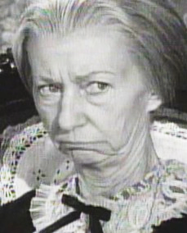
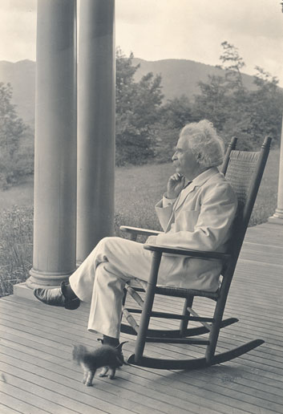
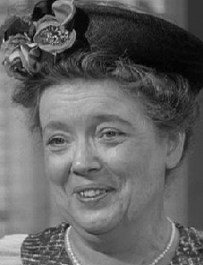
Did you embrace those messages?
Rebel against them?
A little bit of both?

Slide 19
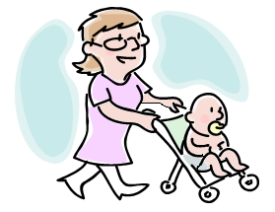

Something else to consider.
Examine your behavior and see if you let emotions affect how you spend money.

Slide 20
Did you ever?
Buy something to make yourself feel better.
I deserve this!
Indulge in Retail therapy.
Buy something to cheer yourself up or to not feel lonely.
Try to keep up with Jones’.
Desire for status—feeling jealousy—(Remember the Jones are in debt up to their eyeballs.)
Spending as a way to express emotion.
I’m sorry we fought. Gifts for a new baby.
Buying to relieve frustration
Fight with your friend or spouse and head for the mall or the auto parts store to treat yourself and calm down?

Slide 21


You probably don’t do this often, if at all. However, if you do, find alternative ways of dealing with the emotions.
Think about constructive things you can do as alternatives to spending money.

Slide 22
Some Positive Alternatives
Exercise---walk, jog, etc.
Spend time with friends
Engage in a hobby you love
Read
Go to the library
Wash your car if it’s summer time
Play on the computer
If you have to shop, go to the thrift store with only a 10 dollar bill
Remember: behavior changes take time. It is a slow process.

Slide 23
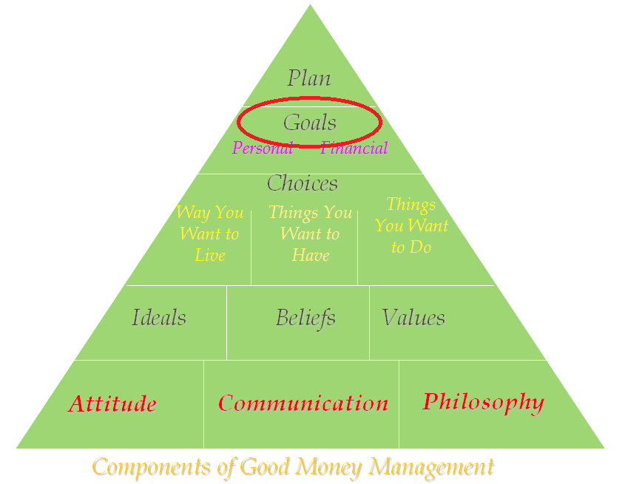
Before you can have a plan,
you need to have some goals.

Slide 24
Set Goals
        Establish SMART goals.
        Write down your goals.
Specific – Clearly identify what your goal is.
Measurable – Have a yardstick for measuring. How much & for how long?
Attainable – Choose a realistic reasonable goal.
Relevant – Must be important to you and consistent with other goals.
Time-Related – Does it have a definite target date.

Slide 25



Set Financial Goals
Set short-term, mid-range, and long-term goals.
Focus on creating a maintenance fund to cover periodic expenses.
Begin to build an emergency fund for unexpected expenses.

Slide 26

Types of Goals: Short term
Short term goals – less than one year
  Long weekend trip
  A new pair of shoes
  New appliance
  Emergency fund of $500.00 - $1,000.00
  Take a class to improve or learn new skill
  Can be stepping stone to larger, long term goals
  Can help you manage your time

Slide 27

Types of Goals: Intermediate
Intermediate – one to five years
  May be right outside your comfort zone.
  Buying a new or used vehicle with cash.
  Pay off all remaining loans except mortgage.
  Have an eight month emergency cash fund.
  Save for down payment for home.
  Finish education.

Slide 28

Types of Goals: Long term
Long term – longer than five years
  Saving for retirement.
  Saving for college education for minor children.
  Having fewer commitments & more free time.
  Achieving your career goal.
  Requires time and planning.
  May be result of a series of short
  or intermediate goals.

Slide 29

Write it down!!!!!!
Written goals are 10 times more likely to be achieved.
Why?
  Reinforces your commitment to them.
  Helps you remember them.
  Makes your accountable.
  Gives you focus.
Write your goal in the positive instead of the negative.
The more detail, the better because it gives our minds more information to work from.

Slide 30
Share your Goals!
Share your goals with important people in your life.
Money arguments often result when couples have differing values & goals.
Compromise may be necessary but each person should determine his or her own goals or determine what are your shared goals.
Good communication helps this process.

Slide 31

Basics of Budgeting

Slide 32
Basics of Budgeting
Understanding cash flow is first step.
    Cash flow is simply the money coming into a household and the money going out again.
Financial conditions can improve when you take better control of your money.

Slide 33

Basics of Budgeting (Con’t)
Understand your actual living expenses and monthly income.
Subtract expenses from income to see where you are.
Once you know where you are,
you can begin to make plans to
get to where you want to be.

Slide 34
Components of a Budget
1) INCOME: EARNING MONEY
2.) TRACK YOUR EXPENDITURES
3.) CATEGORIZE EXPENSES
4.) SUBTRACT EXPENSES FROM INCOME
5.) ANALYZE AND TRIM EXPENSES
6.) SAVE MONEY

Slide 35

Step 1 - Income
GROSS INCOME: your salary before anything is taken out.
NET INCOME: what’s left of your salary after mandatory deductions (taxes, insurance, child support, Chapter 13 payment, 401k)
Budget on regular time only,
not overtime or bonuses.

Slide 36
CALCULATING MONTHLY INCOME
If your income is the same every pay period, multiply the amount by the number of pay periods and divide by 12.
If your income varies each pay period, add the amounts from four consecutive pay periods or two low pays and two high pays and divide by 4.
If you are self-employed, divide what you have earned for the last 4 months and divide by 4. (Unless those were your high months.)
If you are paid every 2 weeks, budget based on 2 paychecks a month. (2013 extra pay May & Nov.)

Slide 37
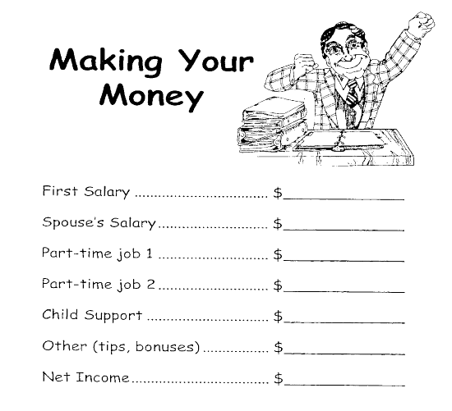
MAKING YOUR MONEY WORKSHEET
Enter your monthly net income on line one of handout page 11.
Add your spouse’s monthly income on line two, if applicable.
Add all other income that you receive on the appropriate lines.
Add all lines to get a total
for your monthly net income.

Slide 38


Step 2 – Tracking Expenses
HOW DO YOU REALLY SPEND YOUR MONEY?
Tracking is writing down all the money you spend for at least one month.
“Small leaks sink great ships.”
--Ben Franklin

Slide 39

Tracking leads to actual numbers which will result in a more realistic budget.
Tracking enables you to detect “leaks” and patterns of spending.
Start today – track your expenses for the next 30 days, at a minimum:
Use a small notebook and transfer to
handouts – pages 5 & 6
or
  Use workbook page 2-6.

Slide 40
Step 3 – Categorize Expenses
Identify your expenses as:
  FIXED: Rent, mortgage, child/spousal support, childcare, Chapter 13 payment.
  FLEXIBLE: Food, utilities, gas & oil for car, clothing, medical expenses, personal grooming, recreation, cleaning supplies, tobacco. (You have the most control over this category.)
  PERIODIC: Real estate taxes, insurances, water bill, trash bill, school expenses, gifts, license tags.
  UNEXPECTED: Car repairs, medical emergencies, home/appliance maintenance.

Slide 41
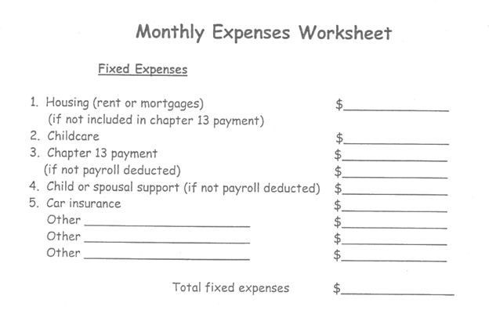
MONTHLY EXPENSES WORKSHEET
Fill out worksheet on HANDOUT pages 8-9.
Only include payments you make from your take-home pay.
Only list mortgage payments on Line 1 if you pay directly to the mortgage company.
Only list Chapter 13 payment on Line 3 if you send money directly to the lockbox.
Total each sub-category and write
your total expenses at the
bottom of the page.

Slide 42

Step 4 – Subtracting Expenses From Income
Now let’s see where you stand.
Enter your total monthly net income on line 1 on handout page 12.
Enter your total monthly expenses on line 2 on handout page 12.
Do the math.
Do not be discouraged if your expenses exceed your income. The first step of any journey is recognizing where you are so you can begin to make a plan to get to where you want to be.

Slide 43
PAYING YOUR EXPENSES
Once you have established your monthly income and expenses, determine how much of each paycheck needs to go into each category.
Have some method to organize the money you will use to pay bills.
Use the method that works best for you.
    Use the envelope method for cash and divide up money for your expenses.
    Have two checking accounts: deposit your money into one account and transfer just the money needed to pay your expenses for the current month or pay period to a separate checking account.
    Look at the bill due dates and arrange bill paying times around them. (Paying on time helps your credit score.)

Slide 44
Step 5 – Analyze and Trim Expenses
You must find room in your budget for these predictable expenses but focus on them to determine if you can reduce them in any way.
    For example, can you get insurance at a better rate?
Analyze periodic expenses to decide how much should be committed each paycheck to cover these.
    Examples, water bill, trash bill, insurance, heating oil, car maintenance, tires.

Slide 45
STEP 5 – (CON’T.)
Focus on flexible expenses next.
  Items like: phone, utilities, clothing, cable, etc.
These are the areas where you have the most control and can begin to make adjustments. Reduce expenses where possible.
Some flexible expenses can be changed into fixed expenses such as signing up for the budget plan with utility companies.

Slide 46
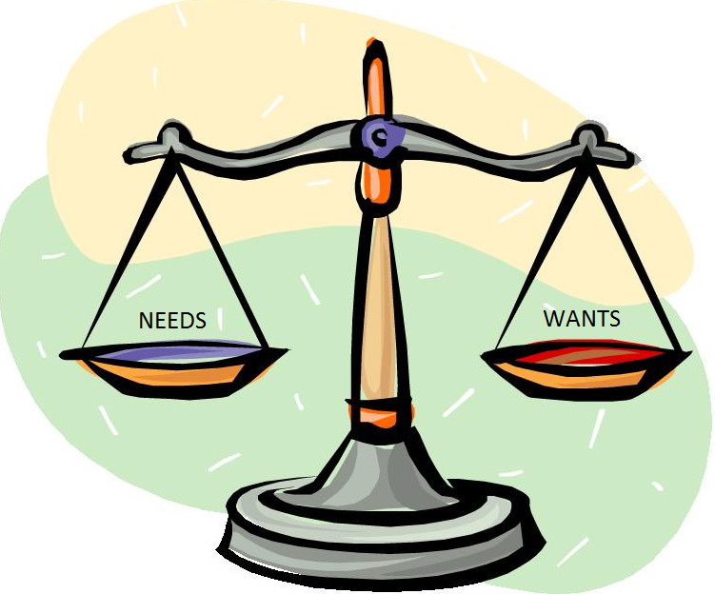




Really Analyze
Wants verses Needs
Bare Essentials
Food
Clothing
Shelter
Near Essentials
Reliable transportation
Insurance coverage
Utilities
Telephone
Personal care expenses
Child care expenses

Slide 47
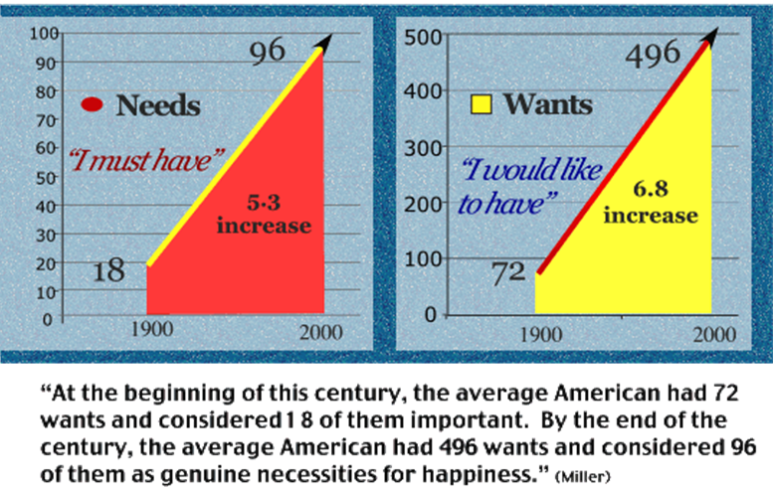
Wants v. Needs
From Overcoming Anxiety by Paul J. Bucknell

Slide 48

Trimming Expenses
TIPS THAT WORK
Check out library books on money savings tips and try to put some of the ideas to work for you.
Make a list of low and no cost rewards to give yourself when you are successful with your plan each month.
Read the, The millionaire Next Door, by Thomas J. Stanley, William D. Danko.
(Yes, you too can be a millionaire.)

Slide 49
Step 6 – Saving Money
Start saving what you can now. Even 20 dollars a week will add up over time. ($20.00 x 52 weeks = $1,040.00)
As soon as you receive your discharge, deposit 5% -10 % of each paycheck into a savings account until retirement. This will put you on a different track and help you gain financial security.

Slide 50


Step 6 –
Saving Money (Con’t)
Put small amounts of money away for a rainy day.
Save bonus income, overtime pay, extra pay checks (twice a year for bi-weekly pay periods), and at least part of any tax refunds.
Collect loose change and small bills.
Have a “NOTHING” week when you try not to spend any extra money.

Slide 51
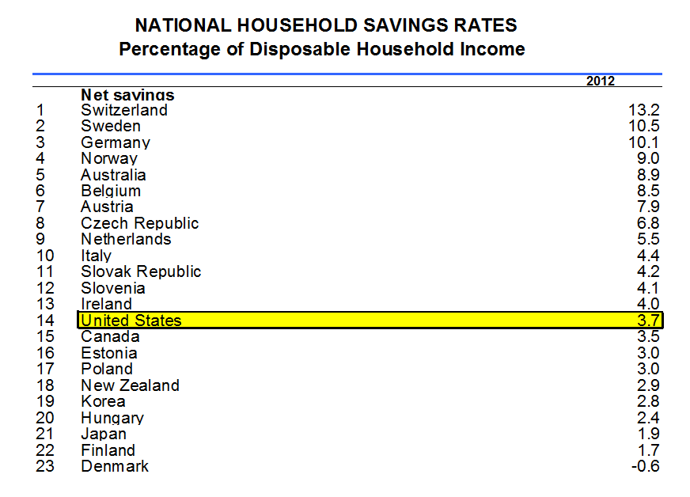

Slide 52

PITFALLS TO SUCCESSFUL MONEY MANAGEMENT
Unrealistic Goals
Emotional uses of Money
Lack of Planning – Impulse buying
Lack of Follow-through of a Plan
Different Approaches conflict
Lack of Communication

Slide 53
HOUSEHOLD RECORD-KEEPING TIPS
Handout pages 21, 22
Comprehensive list (except bankruptcy papers) of what documents to keep and how long to keep them.
At a minimum, keep Certification of Final Payment & Case History and Discharge Order for at least 10 years.

Slide 54

Now it is your time to work.

Slide 55
A Little Money Humor
"The safest way to double your money is to fold it over and put it in your pocket."
- Kin Hubbard
“Too many people spend money they haven't earned, to buy things they don't want, to impress people they don't like.”
- Will Rogers
Car sickness is the feeling you get when the monthly payment is due.
- Author Unknown
“There were times my pants were so thin I could sit on a dime and tell if it was heads or tails.”
-Spencer Tracy

Slide 56
THANKS FOR COMING!
TURN IN EVALUATION FORM.
TURN IN CALCULATORS & PENCILS.
TAKE HOME SMALL NOTEBOOKS AND TRACK, TRACK, TRACK.
HOPE TO SEE YOU AT OUR NEXT SEMINAR!

